Slide 1
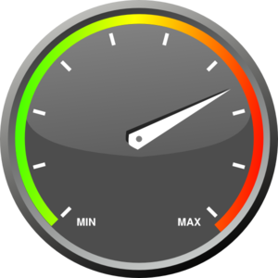
Liquidity Dimensions and Measures
How do we measure liquidity?
Common one-dimensional measures of liquidity
Volume-related measures
Time-related measures
A natural measure of liquidity: the Bid-Ask spread
Relative quoted spread
Focus here
How to measure liquidity using Market Depth Data ?

Slide 2
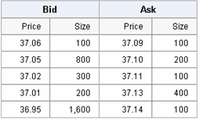
Order Book and Market Depth data
An order in a financial market is an instruction from an investor to buy (bid) or sell (ask) a security on an exchange.
Orders and Limit Orders: - Limit order: Order to buy or sell a stock at a specific price or lower. It doesn't guarantee execution but ensures that the determined price is not exceeded. - Market order: Order to buy or sell immediately at current market price(s). It guarantees execution, but doesn't allow a control over the price.
Order Book

Slide 3
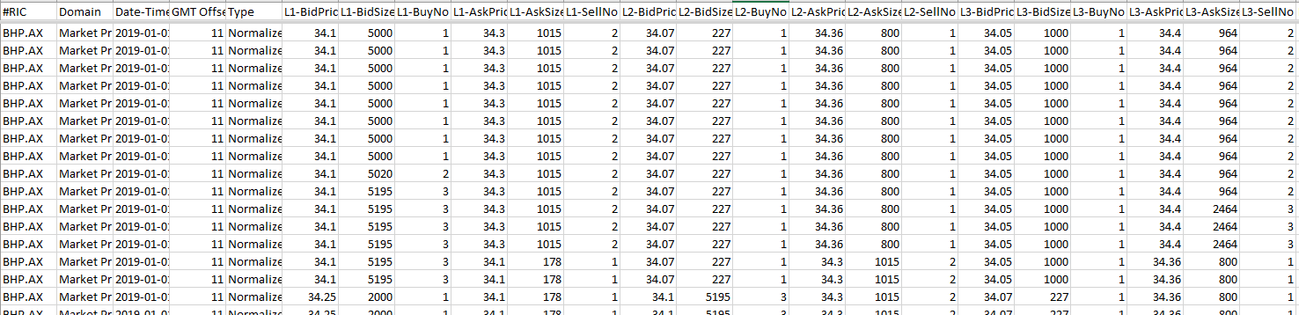
Market Depth data
The content of the order book is provided through TRTH by Market Depth data. Basically, here are the data available (with k from 1 to 20 for ASX securities):
L_{k}-Bid Price
L_{k}-Bid Size
L_{k}-Number of Buyers
L_{k}-Ask Price
L_{k}-Ask Size

Slide 4
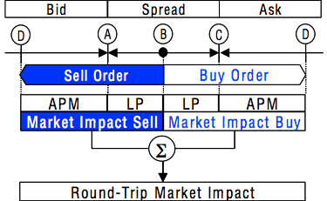
Liquidity Dimensions and Measures
Liquidity as a multi-dimensional variable
Transaction costs and the Market Impact approach
The liquidity premium
The Adverse Price Movement (APM)

Slide 5
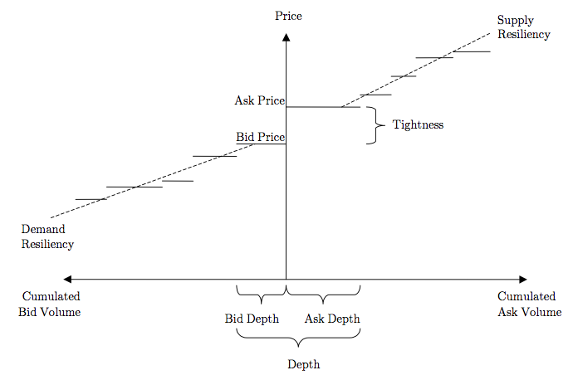
Liquidity Dimensions and Measures
The four dimensions of liquidity
Market Breadth (i.e. trading cost)
Market Depth (i.e. trading quantity)
Resiliency (i.e. price impact)
Immediacy (i.e. trading speed)

Slide 6
Liquidity Measures
XLM liquidity measure - Intraday liquidity
The Xetra Liquidity Measure (XLM) introduced by Peter Gomber and used by the German securities exchange Xetra is a multi-dimensional measure of liquidity, based on the market impact, and which measures the liquidity of a security for a given trade (amount invested).
The XLM measure offers an alternative and objective way to measure liquidity, being derived from the direct benefit for the investors, i.e. transaction costs. To sum-up the general idea of XLM measures: the lower the transaction costs are, the higher the liquidity.

Slide 7
Additional information
XLM liquidity measure on XETRA
XLM integrates the market impact costs into a single figure.
Since July 2002, the measure has been calculated over the entire trading day for all shares in Continuous Trading on Xetra.
The lower the XLM, the lower the market impact costs incurred in the trading of a share and the higher the liquidity of the share and its trading efficiency.
http://www.xetra.com/xetra-en/trading/market-quality/xlm-xetra-liquidity-measure

Slide 8
2. Market depth data
Date[G]:The date that a quote or trade occurs.
Time[G]:The GMT time that a quote or trade occurs.
GMT Offset:The value to be added to GMT time to make a local time
#RIC: A unique code that represents a security.
L1-BidPrice: The price of the highest bid
L1-BidSize: The volume of all orders with highest bid
L1-BuyNo: The number of orders with highest bid
L2-BidPrice: The price of the second highest bid
L2-BidSize: The volume of all orders with second highest bid
L2-BuyNo: The number of orders with second highest bid
Etc.

Slide 9
Market Depth data sample
BHP.AX,02-JAN-2012,19:05:01.737,+11,Market Depth,34.41,60,34.49,1734,34.39,20000,34.6,5300
BHP.AX,02-JAN-2012,20:00:02.888,+11,Market Depth,34.41,60,34.49,1734,34.39,20000,34.6,5300
BHP.AX,02-JAN-2012,20:00:03.017,+11,Market Depth,34.41,60,34.49,1734,34.39,20000,34.6,5300
BHP.AX,02-JAN-2012,20:00:03.467,+11,Market Depth,34.41,60,34.49,1734,34.39,20000,34.6,5300
BHP.AX,02-JAN-2012,20:00:03.469,+11,Market Depth,34.41,60,34.49,1734,34.39,20000,34.6,5300
BHP.AX,02-JAN-2012,20:00:03.491,+11,Market Depth,34.41,60,34.6,5300,34.39,20000,34.62,180
BHP.AX,02-JAN-2012,20:00:03.501,+11,Market Depth,34.41,60,34.6,5300,34.39,20000,34.62,180

Slide 10
Manipulating market depth data
Challenges
How Financial users can make sense from the huge amounts of data?
Allow the user to assimilate information as clearly and as fast as possible
Minimal efforts for the user
Tool under development
3D + Animation (show many data in one picture)
Automated process
Fit for a broad range of data
Any price, volume, time-interval…

Slide 11
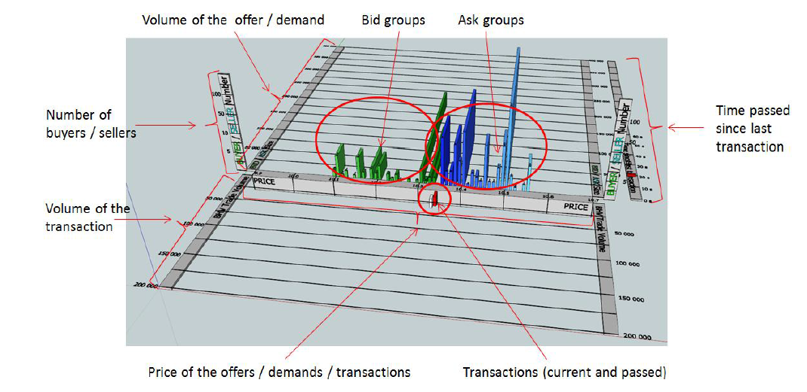
SketchUp 3D model
3D components linked together, made dynamic by SimFonIA plugin

Slide 12
Activities
We will be using intraday measures from previous activity
04. Aggregating intraday series in R
05. Building Intraday returns in R

